Slide 1

WELCOME
TO BHOJANALYA
Revolutionize Your Meal Planning

Slide 2

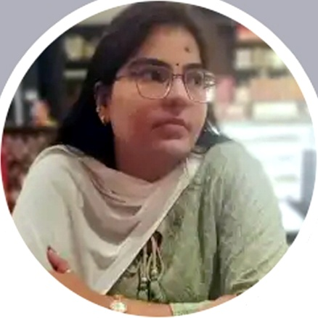
OUR GUIDES
Prof. Arvind Tiwari
Prof. Neetika Gond
CSED, KNIT, SULTANPUR
CSED, KNIT, SULTANPUR

Slide 3
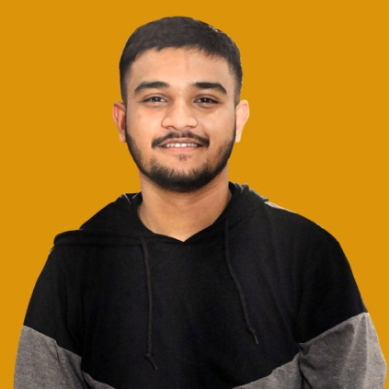
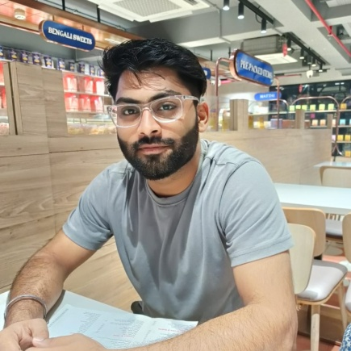
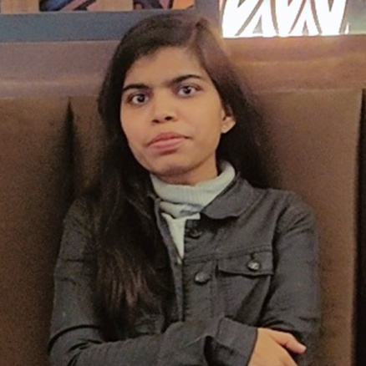

TEAM MEMBERS
01
02
03
04
Umang Varshney
Mohit Kumar Singh
Vidushi Gupta
Shantanu Kumar
CEO, Bhojanalya
CFO, Bhojanalya
CMO, Bhojanalya
COO, Bhojanalya

Slide 4
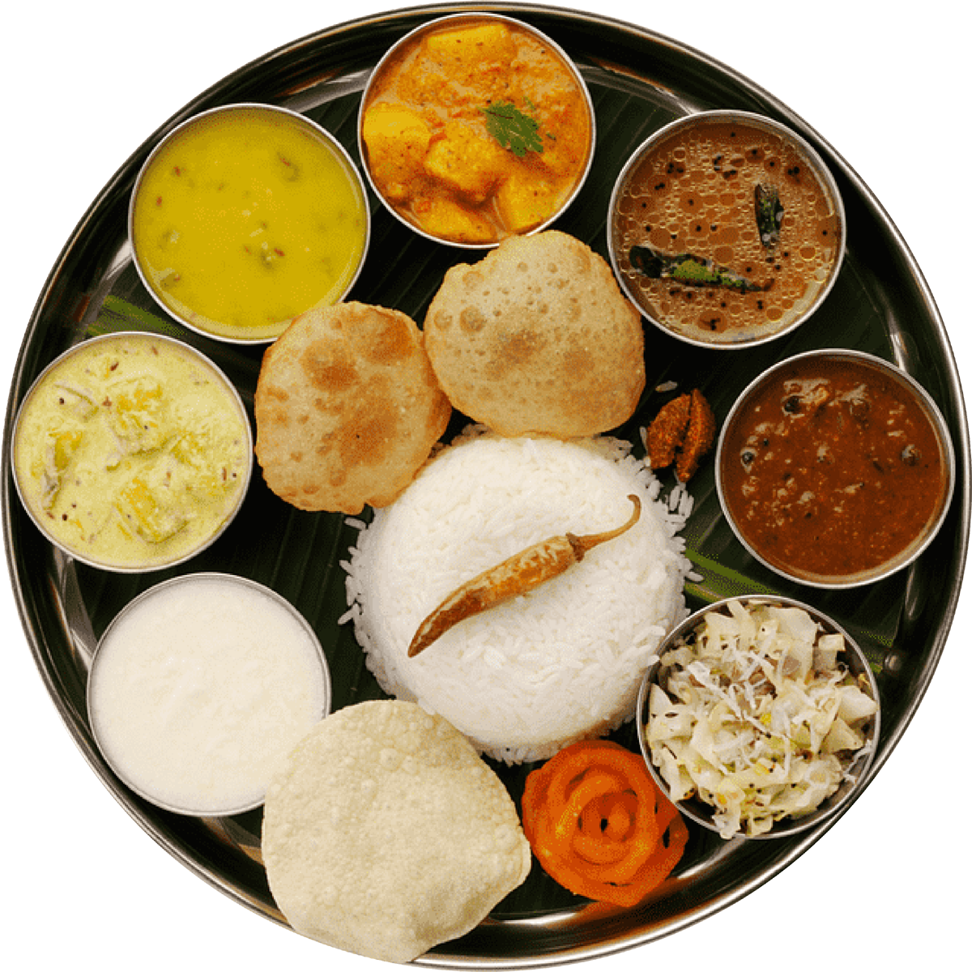
Introduction
Welcome to the presentation on Enhancing the Dining Experience through the Bhojanalya Mobile App. This app & Mobile app introduces a Slot Booking Feature to streamline the dining process for students and people living away from home. Let's explore its potential benefits and functionalities.

Slide 5






Steps To Place Order
06
Enjoy Food
03
Choose Food
04
Book Slot
01
Register
02
Choose Time
05
Complete Payment

Slide 6
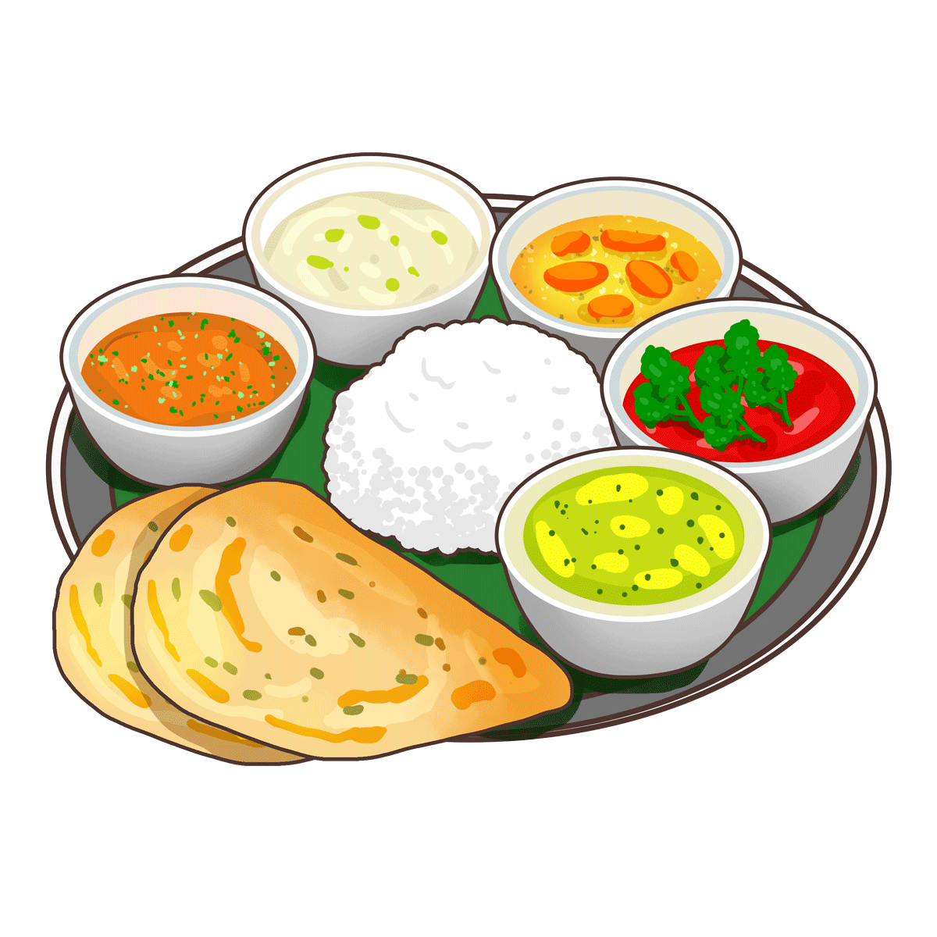
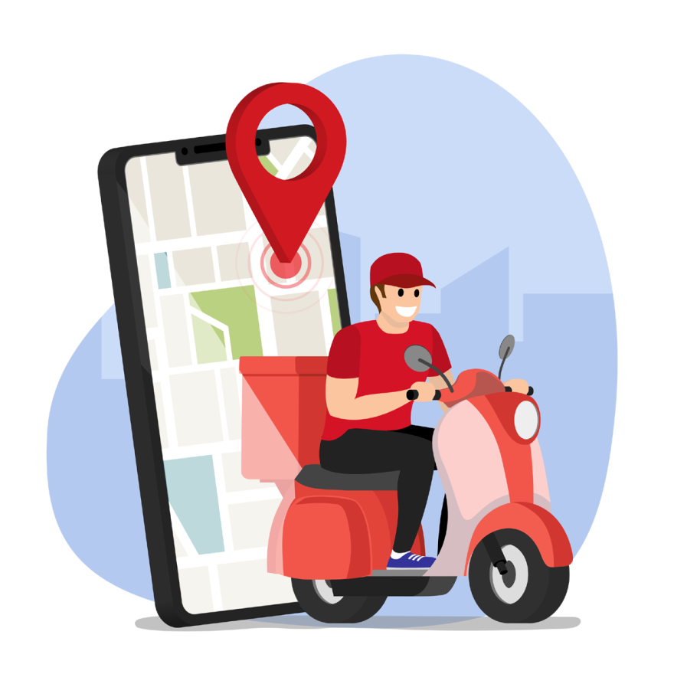

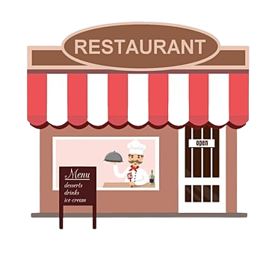
A
B
C
D
Features
Provided By Bhojanalya
Slot Booking
Varity of Restaurants
Fast Delivery
Dine-In

Slide 7
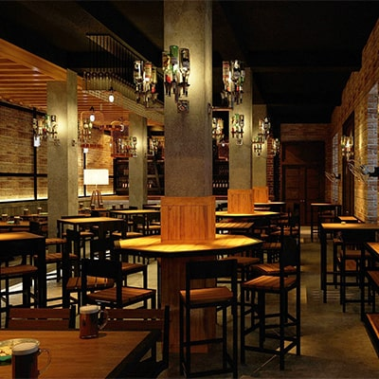
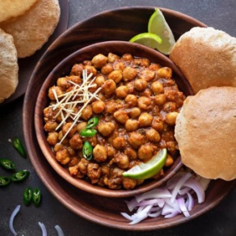
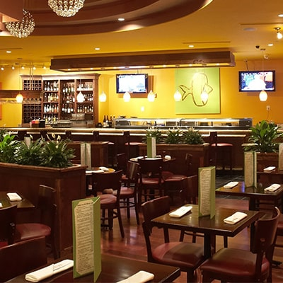
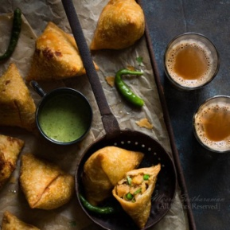
Slot Booking
Fast Food Delivery
Variety Of Restaurants
Efficient Dining Management
At Bhojanalya, we offering a seamless and efficient food delivery service that brings your favourite meals straight to your door. Our platform connects you with a wide variety of local restaurants.Experience the ultimate convenience of dining at home without compromising on taste or quality.
The Bhojanalya app also offers benefits for dining hall management. It enables staff to optimize resource allocation, manage capacity, and ensure a smooth flow of service, for coustmer satisfaction.
At Bhojanalya, we celebrate culinary diversity by partnering with a wide array of local restaurants, offering you an extensive selection of cuisines to suit every taste and preference.
The Bhojanalya Mobile App is designed to revolutionize the dining experience. With its user-friendly interface, users can easily browse available dining slots, book their slots, and plan their meal for their booked slots.
D
C
About Features
B
A
Slot Booking
Delivery
Dine - In
Restaurants

Slide 8




Benefits Of Slot Booking
Benefit
Benefit
Benefit
Benefit
1
2
3
4
COST
QUALITY
VARIETY
TIME
Considering students in mind, we provide food at affordable cost
You will get the food with high quality at bhojanalya
You can choose different restaurant for every meal according to utility
Slot booking feature reduce your timing for having food

Slide 9

User feedback through surveys and data analysis is essential for continuously refining the Bhojanalya app to enhance the student dining experience
01
Feedback &
Improvement
Strategic implementation, effective communication, and collaboration with nearby restaurants are key for the successful adoption of the Bhojanalya app
02
Adaptation &
Implementation
Integrating AI for recommendations, expanding locations, and adding features like ratings can make the Bhojanalya app an essential tool for users and restaurant owners
03
Future Development
04
Enhancing the Bhojanalya App to Become an Indispensable Tool for Users and Restaurant Owners.
Goal

Slide 10








Conclusion
SLOT BOOKING
REGISTER
BOOK FOOD
DINE - IN
BHOJANALYA
A USER-FRIENDLY
APP FOR ORDERING AND DINE-IN FOOD
DELIVERY
PAYMENT
VARIETY OF RESTAURANTS
GRAB FOOD

Slide 11

Location
KNIT, SULATANPUR,
UTTAR PRADESH

Slide 12

This Photo by Unknown author is licensed under CC BY.

